Slide 1
Genome Sequence Assembly: Algorithms and Issues
Fiona Wong
Jan. 22, 2003
ECS 289A

Slide 2
Presentation overview
Background
Shotgun sequencing, whole genome shotgun sequencing
Assembly algorithms
Repeat sequences
Scaffolding techniques
Assembler quality issues
Conclusions
References

Slide 3
Gene Sequencing
Genome
  A sequence of DNA base pairs that control how cells function in organisms
Genomics
  Study of genomes
  Decoding entire genomes
Current research techniques decode DNA base pairs accurate for about 600-700 nucleotides at a time.

Slide 4
Gene Sequencing
Shotgun Sequencing (Fred Sanger 1982)
1. Physically break the DNA
2. DNA sequencer reads the DNA.
3. Assembler reconstructs the original sequence.
Assembly is challenging
  Data contains errors
  DNA has repetitive sections called repeats.
  Gaps

Slide 5
Gene Sequencing
Finishing
  Solve errors in the assembly process
  Costly – large human intervention and special lab techniques

Slide 6
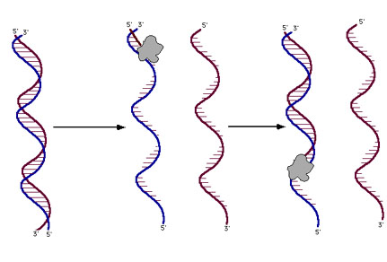
DNA Sequencing
Using heat, separate the DNA into strands. The primer binds to the intended location and polymerase starts lengthening the the primer.

Slide 7
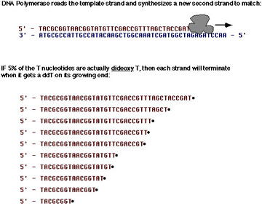
DNA Sequencing

Slide 8
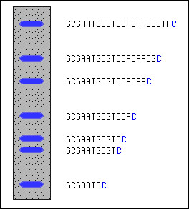
DNA Sequencing
To find out fragment sizes,
Use gel electrophloresis
positions and spacing show
relative sizes
Fragments are terminated by a
specific known nucleotide

Slide 9
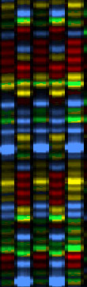
DNA Sequencing
In reality the gels look like this.
Using gels researchers then read the
sequence from it bottom to top.
An automated DNA sequencer does
this for large scale readings. (3-4
meters long!)

Slide 10
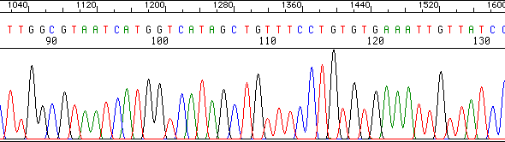
DNA Sequencing
Example output – Fragment of one file (usually spans 600-700 nucleotides)
Sequencer plots the fragments

Slide 11
Gene Sequencing
Shotgun Sequencing for large genomes
  First, break DNA into bacterial artificial chromosomes (BACs).
  Map the BACs to the genome and obtain a tiling path.
  Apply the shotgun method to each BAC.
The National Institutes of Health and the National Science Foundation fund 'libraries' of BAC clones.
BACs have large piece of human genomic DNA (100-300 kb) that overlap randomly.
BACs are replicated to produce millions of human DNA replications.
Shotgun sequencing is then applied to the BACs. Based on the knowledge of the overlapping sequences, researchers use this to construct the original sequence

Slide 12
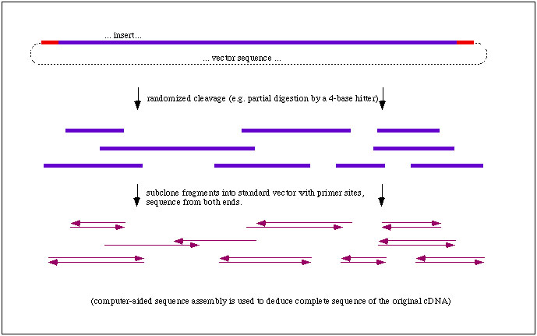
Gene Sequencing

Slide 13
Gene Sequencing
Whole-Genome shotgun sequencing
  Does not use BACs but the original fragments.
  Use human genome fragments of 2-10 kb and sequence those
  Computationally expensive
Eugene Myers and colleagues successfully applied WGSS
  Assembled the entire genome of a fruit fly
  Assembler for large genomes.
  135 Mbp genome
  2001 - assembled the human genome

Slide 14
Gene Sequencing
WGSS procedures
  Clones and Coverage
    1. Shatter the DNA
    2. Pieces of DNA are inserted into cloning vectors, or, clones.
    3. Escherichia coli multiplies the plasmid.
    4. Sequence both ends of each clone insert which yields clone-pairing data.
    5. Try to have more than 99% of the genome covered by reads.

Slide 15
Gene Sequencing
WGSS procedure continued
  Assembly
    1. Combines all sequencing reads into contigs based on sequence similarity between reads.
    2. Idea: Overlapping reads are presumed to be from the same area of the genome.

Slide 16
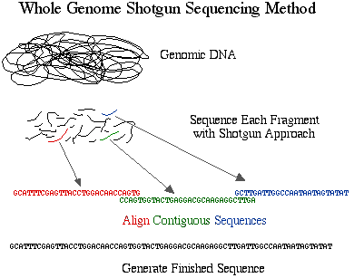
Gene Sequencing

Slide 17
Gene Sequencing
WGSS procedure continued
1. Assembly can be improved by knowing more about clone mates and their size distribution.
  Finishing
    Assemblers produce too many contigs in practice.
    Finishing is taking contigs and yielding a complete sequence.
    Scaffolder orders contigs into scaffolds based on clone-mate pair information.

Slide 18
Gene Sequencing
WGSS procedure continued
    In each scaffold, the gaps are determined by the order of the contigs.
    Sequence gaps - gaps between configs in the same scaffold.
    Physical gaps - gaps between scaffolds. These are difficult to fill and require complex lab techniques

Slide 19
Gene Sequencing
Advantage to shotgun sequencing
less likely to make mistakes because the
location for each BAC is known and there are less
pieces to assemble
Disadvantage is it is computationally intensive
WGSS is faster and less expensive
Disadvantage is that it is more prone to errors – more fragments
and more difficult to assemble correctly

Slide 20
Gene Sequencing
Assembly Algorithms
    Shotgun sequencing assembly problem
      Find the shortest common superstring of a set of sequences.
      Given strings {s1, s2, …} find the shortest string T such that every si is a substring of T.
      This is NP-hard.
      Approximation algorithm for this is efficient, the greedy algorithm.

Slide 21
Gene Sequencing
Assembly Algorithms
    Shotgun sequencing assembly problem continued.
      Greedy algorithms were the first successful assembly algorithm implemented.
      Used for organisms such as bacteria, single-celled eukaryotes.
      Because of the greedy algorithm’s limitations, two other algorithms were derived.

Slide 22
Gene Sequencing
Assembly Algorithms
    Overlap-layout-consensus
      Algorithm based on graph theory
      A graph is constructed
        nodes are reads
        edges represent overlapping reads
      A contig is a simple path in the graph
      Simple path – contains each node at most once

Slide 23
Gene Sequencing
Assembly Algorithms
    Overlap-layout-consensus
      An assembler builds the graph
      Output is a set of nonintersecting simple paths, each path being a contig.

Slide 24
Gene Sequencing
Assembly Algorithms
    Eularian path
      graph theory
      Eularian path – a path that visits all edges of a graph
      Breaks reads into overlapping n-mers.
      Source – n-1 prefix and destination is the n-1 suffix corresponding to an n-mer.
      Basic problem is to find a path that uses all the edges.
      Eularian path is more efficient.
      In practice both are equally fast.
Example - ACTTA and CTTAG represents ACTTAG

Slide 25
Gene Sequencing
Repeats in the sequence
  Assembly programs should detect repeats in the assembly process and not after.
    Incorrect genome reconstruction
  Assemblers should try to resolve correctly as many repeats as possible.
    Avoid intensive human labor

Slide 26
Gene Sequencing
Detecting repeats
  Statistical methods
    Assemblers assume that reads are sampled uniformly at random.
    Using this idea, assemblers deduce that areas covered by a large number of reads may show an over-collapsed repeat.
    Problems with this - samples are not uniformly distributed.

Slide 27
Gene Sequencing
Detecting repeats
  Euler assembly program
    Finds repeats by complex parts of the graph constructed during the assembly process.
    Researchers look into these complex areas to try and resolve repeats.
    Assemblers can use clone mate information to find incorrect assemblies. This is based on finding clone-mate pairs too close or too far from one another.

Slide 28
Gene Sequencing
Detecting repeats
    Assemblers can sometimes find differences between repeats that can determine correct sequencing
  Techniques for repairing sequencing errors during repeat resolution
    find clusters of reads where the clusters share differences.
    Ie) four reads contain an A , four contain a B. it is likely that the first four reads are from one copy and the last four from a different one.

Slide 29
Gene Sequencing
Detecting repeats continued
    Drawbacks are if certain areas of the sequence have low coverage.
    Difficult to separate from true polymorphism
  Unresolved repeats
    directed sequencing experiments
    TIGR Assembly

Slide 30
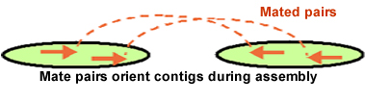
Gene Sequencing
Scaffolding
  Scaffolding groups contigs into subsets with known order and orientation.
  Nodes are contigs
  directed edge is between two nodes when mate pairs bridge the gap between them.
  Mate pairs , if in different contigs, have a 1% chance of being neighbors.

Slide 31
Gene Sequencing
Scaffolding continued.
  Three basic problems
    Find all connected components
    Find a consistent orientation for all nodes in the graph. Nodes have two types of edges
      Same orientation
      Different orientation
      Consistent orientation possible only if all undirected cycles have an even number of reversal edges.
      Optimization problem – find the smallest number of edges to be removed so that no cycle has an odd number of reversal edges
    Fit the edges on a line so the least number of constraints is invalidated. (NP-complete)

Slide 32
Gene Sequencing
Scaffolding
  Complex because of data errors.
  Effect of errors can be reduced by simple heuristics.
    Ie ignore linking information in repeat areas
  Scaffolding orientation and order techniques:
    Physical mapping
    using markers along a DNA strand as independent information for scaffolding software.
    involves making large scale maps of landmarks that lie along the the chromosomal DNA
    Markers are known sequences of nucleotides, tags.

Slide 33
Gene Sequencing
Scaffolding continued
  tags are searched for in the contigs
  Good analogy:
    Like taking copies of a map of a highway connecting Sydney and Melbourne, cutting this into many pieces and then trying to reconstruct the original map from the fragments.
    We find pieces that show cities and their overlapping pieces of other cities, and from that information, reconstruct the order.

Slide 34
Gene Sequencing
Scaffolding continued
  Sequences of closely related organisms are also used as scaffolding information.
  Example – aligning scaffolds of a mouse genome to the human genome
  Issues of scaffolding techniques
    Errors in length of inserts (affecting distances between clone mates)
    Physical mapping is error prone.
    Bambus - scaffolder that factors in linking information confidence

Slide 35
Gene Sequencing
Scaffolding continued
    first builds a sequence based on linking information with high confidence then factors in linking information with lower confidence.
Assessing Assembly Quality
    misassembly correction is expensive
    some assemblers have a simple quality-control method that does not capture larger errors
    test assembly software if we know a complete sequence (artificial or real)

Slide 36
Gene Sequencing
Assessing Assembly Quality
  Common measures of quality are:
    number and sizes of contigs
    Assumption: few large contigs is better than many small contigs.
    True because there are less gaps in the former, but, does not account for the possibility of misassemblies.

Slide 37
Conclusion
GOAL is to complete the DNA sequence of an organism.
    Assemblers can reduce human effort in the finishing phase.
    Assemblers need better quality-control tools and measures.

Slide 38
References
Genome Sequence Assembly:Algorithms and Issues, 2002 ,Mihai Pop, Steven L. Salzberg, Martin Shumway, IEEE Computer, v35(7)
http://seqcore.brcf.med.umich.edu/doc/educ/dnapr/sequencing.html
http://www.bio.davidson.edu/courses/genomics/method/shotgun.html
http://www.cs.sunysb.edu/~skiena/648/presentations/genomeassembler.htm
http://www.abc.net.au/science/slab/genome/story.htm
http://www.ornl.gov/hgmis/project/info.html

